Slide 1
Artificial & Computational Intelligence DSE **ZG557
A* Algorithm
Rashmi K

Slide 2
Informed Search
A*

Slide 3
A* Search
Expands the node which lies in the closest path (estimated cheapest path) to the goal
Evaluation function f(n) = g(n) + h(n)
g(n) – the cost to reach the node / path cost
h(n) – the expected cost to go from node to goal
f(n) – estimated cost of cheapest path through node n

Slide 4
Optimality of A*

Slide 5
A* Search
Test for Admissibility
Expands the node which lies in the closest path (estimated cheapest path) to the goal
Evaluation function f(n) = g(n) + h(n)
g(n) – the cost to reach the node
h(n) – the expected cost to go from node to goal
f(n) – estimated cost of cheapest path through node n
A heuristic is admissible or optimistic if , 0 ≤ h(n) ≤ h*(n), where h*(n) is the actual cost to reach the goal

Slide 6
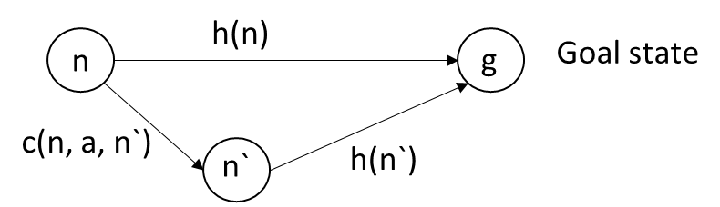
A* Search
Optimal on condition
h(n) must satisfies two conditions:
Admissible Heuristic – one that never overestimates the cost to reach the goal
Consistency – A heuristic is consistent if for every node n and every successor node n` of n generated by action a, h(n) <= c(n, a, n`) + h(n`)

Slide 7
Consistency
In A*, the triangle inequality is related to the consistency property of the heuristic function. For a heuristic h(n), the triangle inequality ensures that:
h(n)≤c(n,n′)+h(n′)
Where:
h(n) is the estimated cost from node n to the goal,
c(n,n′) is the actual cost between node n and its neighbor n′,
h(n′) is the estimated cost from n′ to the goal.

Slide 8
Triangle inequality
It states that for any three points A, B, and C, the direct distance between two points cannot be greater than the sum of the distances through a third point.
d(A,C)≤d(A,B)+d(B,C)

Slide 9
Example
Imagine three cities on a map: A, B, and C. The direct distance from A to C is shorter or equal to the sum of the distances from A to B and B to C. This is the triangle inequality in action.
d(A,C)=10
d(A,B)=6
d(B,C)=5
Here:
d(A,C)≤d(A,B)+d(B,C) (10≤6+5)

Slide 10
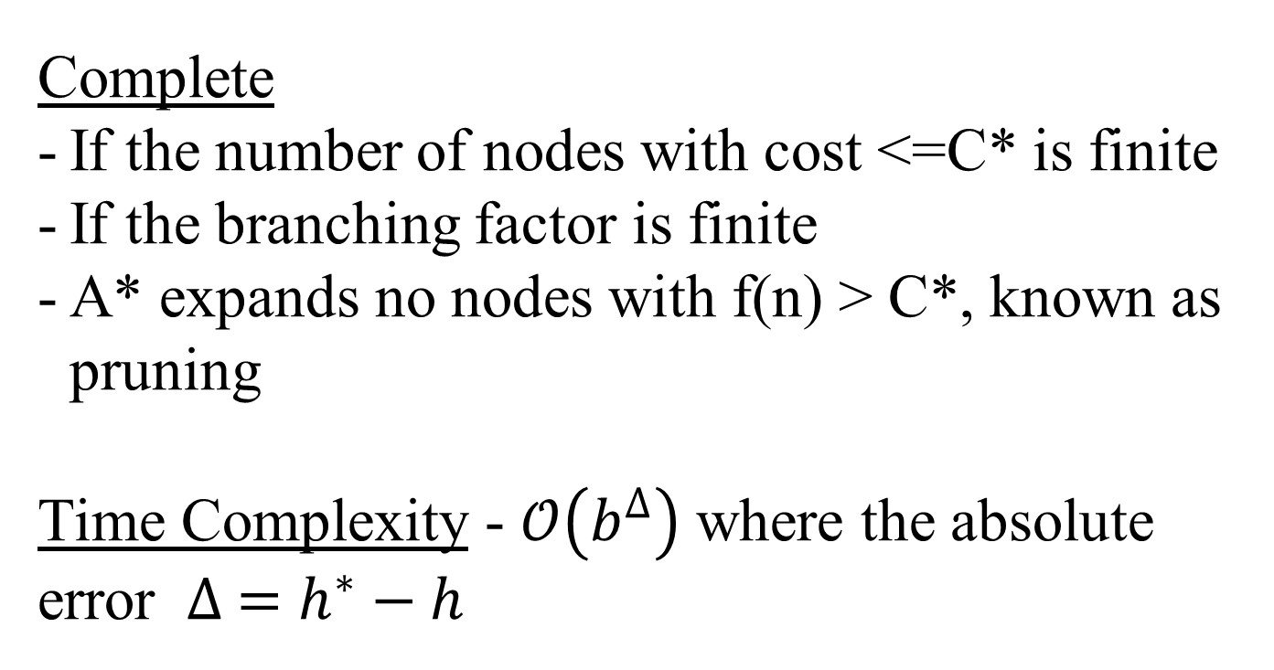
Complete
If the number of nodes with cost <=C* is finite
If the branching factor is finite
A* expands no nodes with f(n) > C*, known as pruning
Time Complexity - $𝒪\left(b^{∆}\right)$ where the absolute error $∆ =h^{∗}−h$

Slide 11
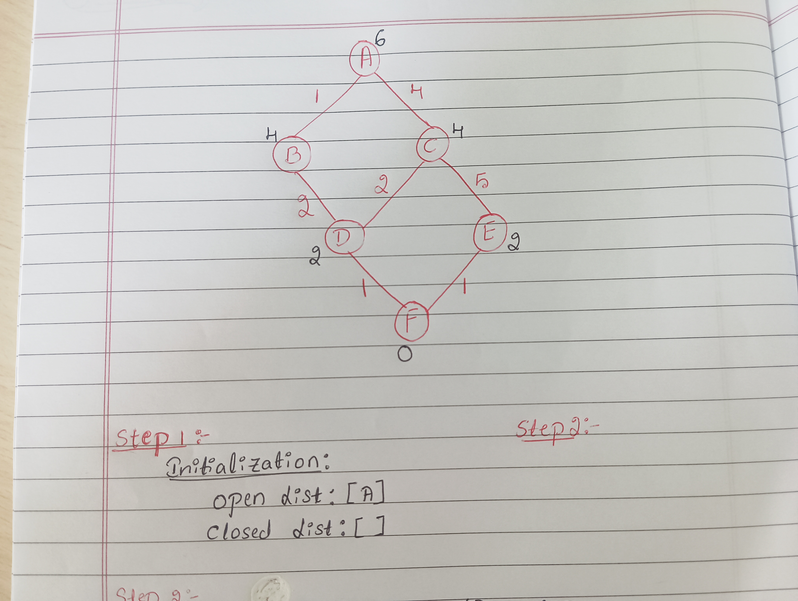
Example

Slide 12
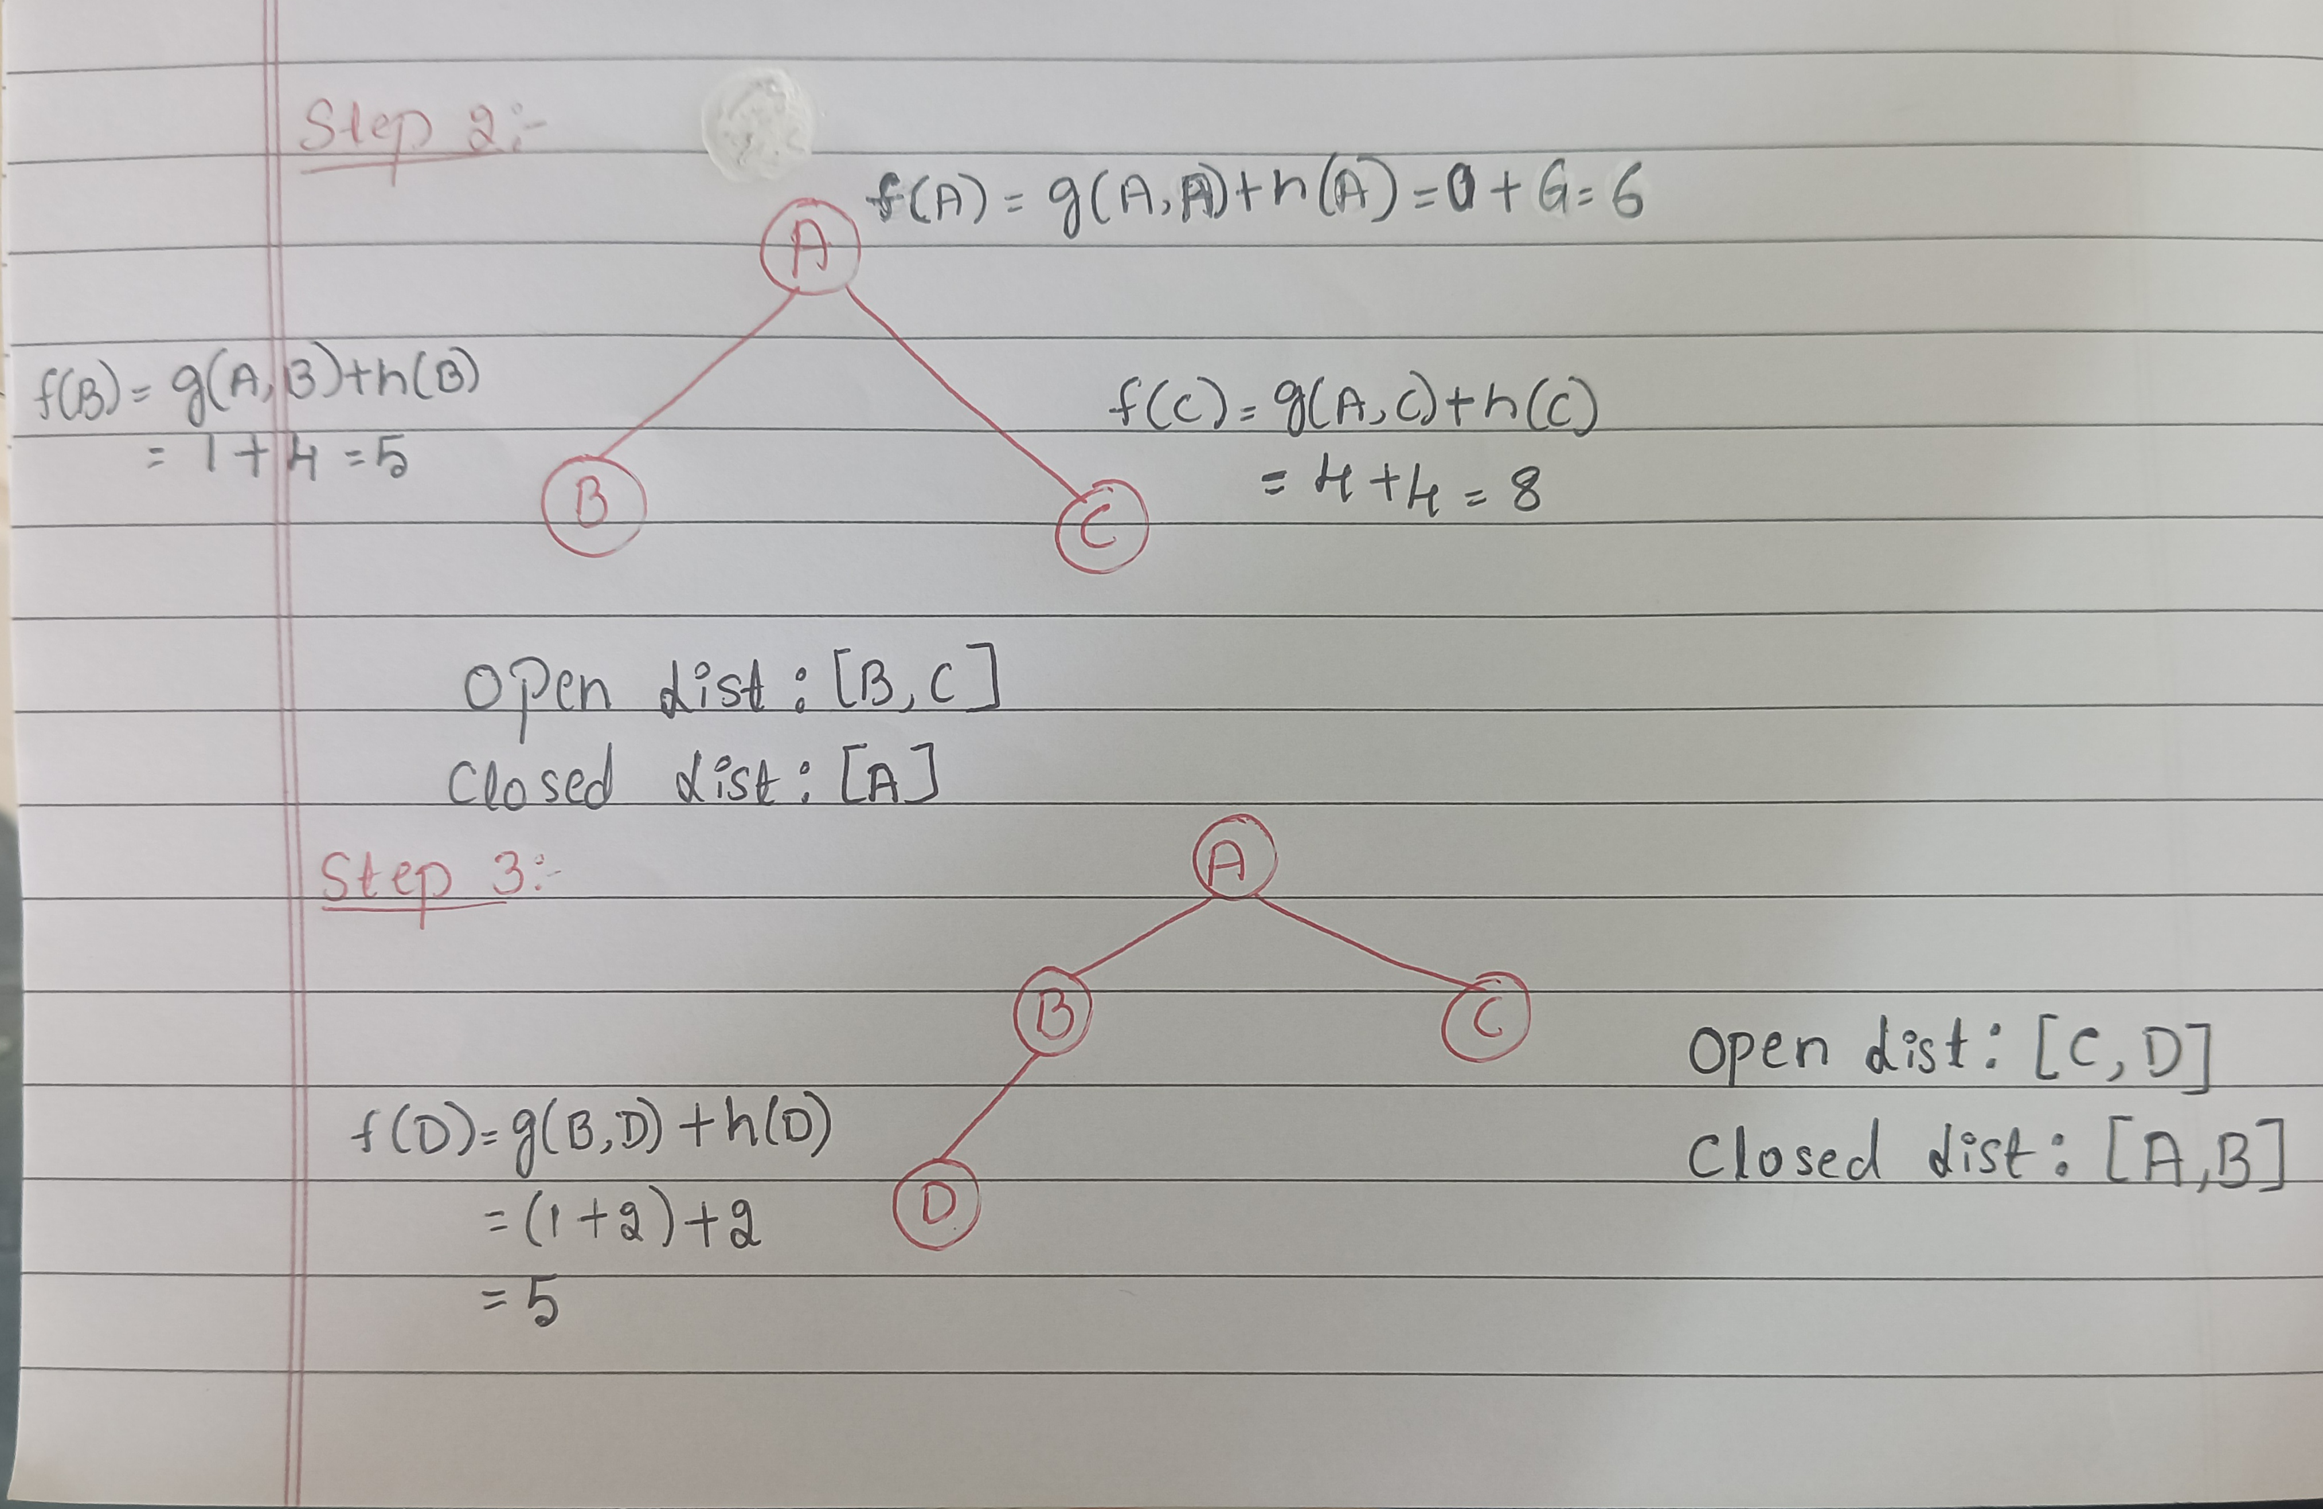
Cont…

Slide 13
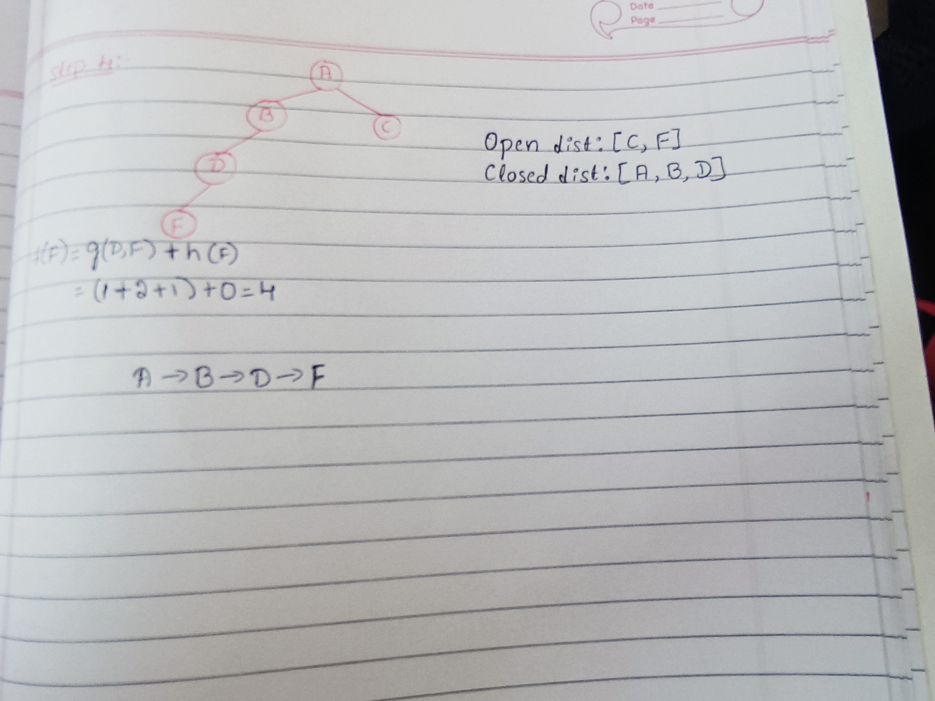
Cont…

Slide 14
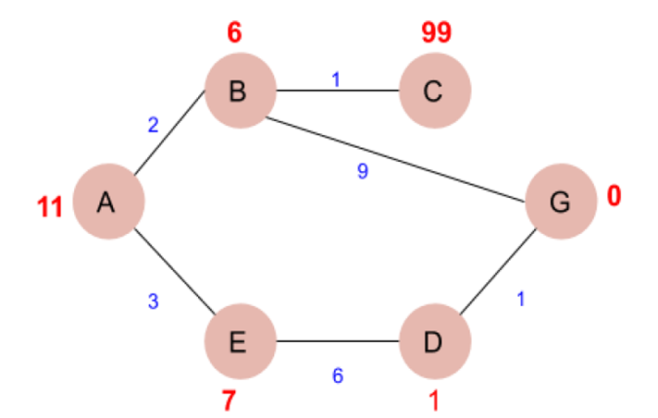
Example 1

Slide 15
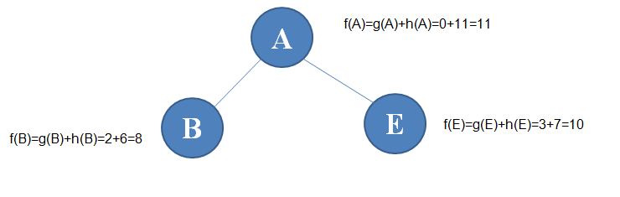
Step 1:
A
f(A)=g(A)+h(A)=0+11=11
B
E
f(E)=g(E)+h(E)=3+7=10
f(B)=g(B)+h(B)=2+6=8
Step 2:
C
G
f(G)=g(G)+h(G)=(2+9)+0=11
f(C)=g(C)+h(C)=(2+1)+99=3+99=102

Slide 16
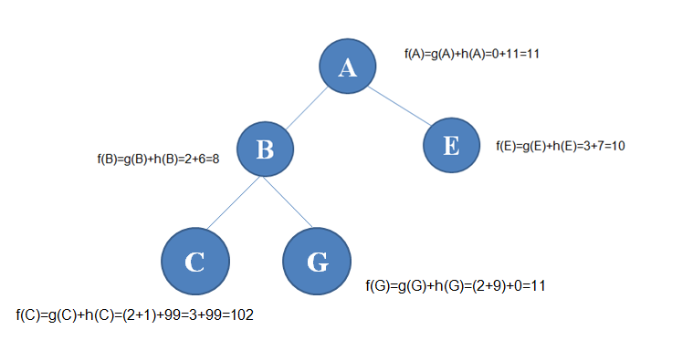
Step 3:
D
f(D)=g(D)+h(D)=(3+6)+1=10

Slide 17
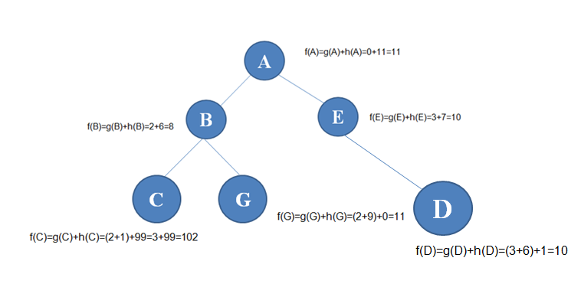
Step 4:
G
Path cost :- A→E→D→G = 10
f(G)=g(G)+h(G)=(3+6+1)+0=10

